Slide 1

Exploratory analysis
Center for Health Data Science

Slide 2
OVERVIEW
Count matrix and normalization
RPKM/FPKM-TPM-DESeq2
Exploratory Analysis
Transformation, Dimensionality reduction and clustering
Workflow
Differential Expression Analysis
Comparison between
conditions
Functional Analysis
Gene-gene correlation
Networks
GO term

Slide 3
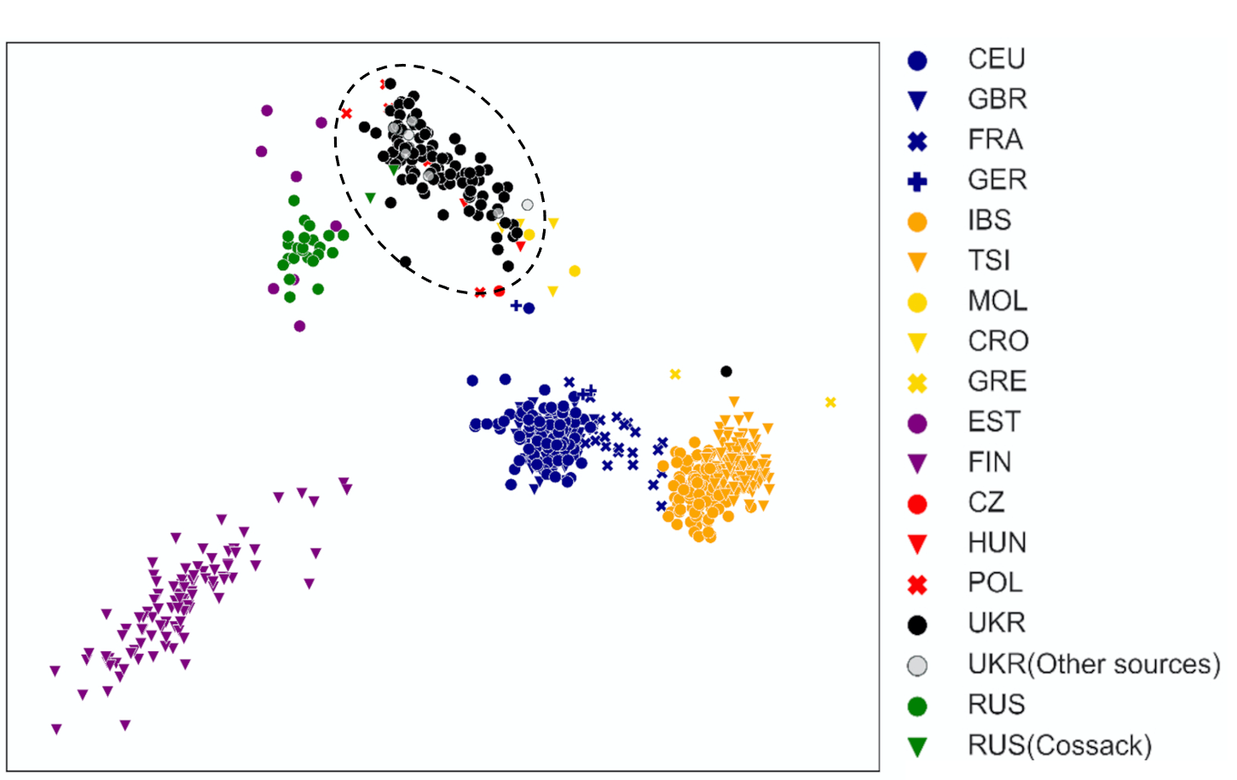
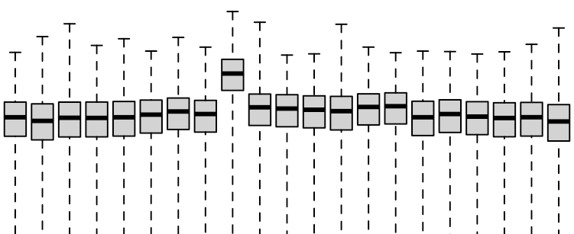
Exploratory Analysis
Does the ‘relationship’ between sample groups fit our expectation?
Sources of variation in the dataset?
Variance of variable of interest
Confounding variable variances
Technical
Sample-level count distributions and variances can help identify outliers
Explore sample similarity with dimensionality reduction (PCA, MDS, t-SNE, UMAP) and clustering.
PC2
PC1

Slide 4
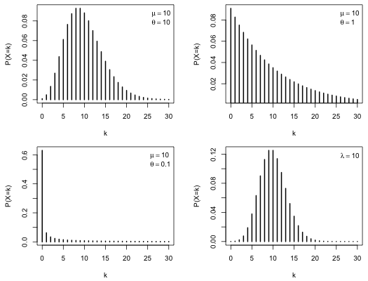
Exploratory Analysis - Data transformation
Distribution of RNAseq count data:
Model with a Poisson distribution (PD)?
PD assumes mean == variance, count distributions are overdispersed! Negative binomial distribution.

Slide 5
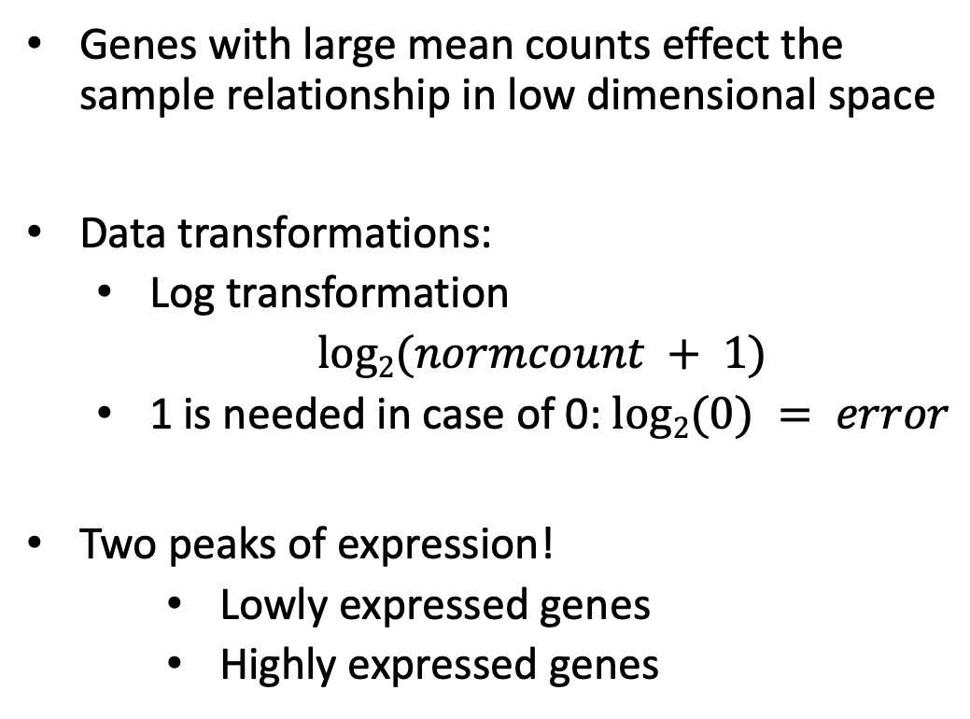
Data Tranformation – log2
Genes with large mean counts effect the sample relationship in low dimensional space
Data transformations:
Log transformation
$log2(normcount + 1)$
1 is needed in case of 0: $log2(0) = error$
Two peaks of expression!
Lowly expressed genes
Highly expressed genes
log2(norm counts +1)

Slide 6
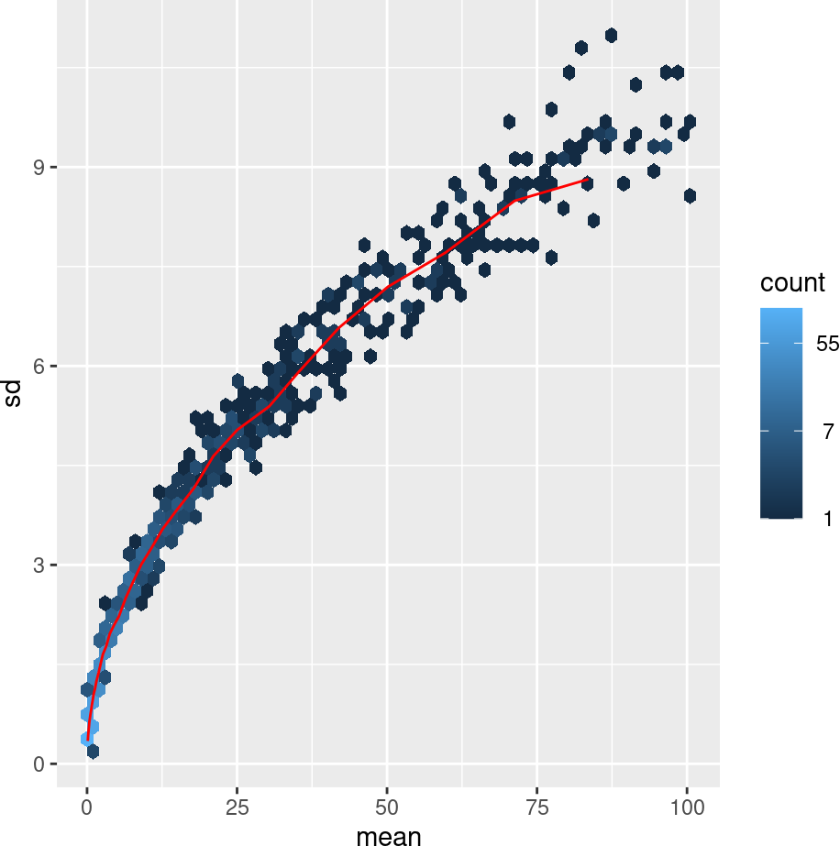
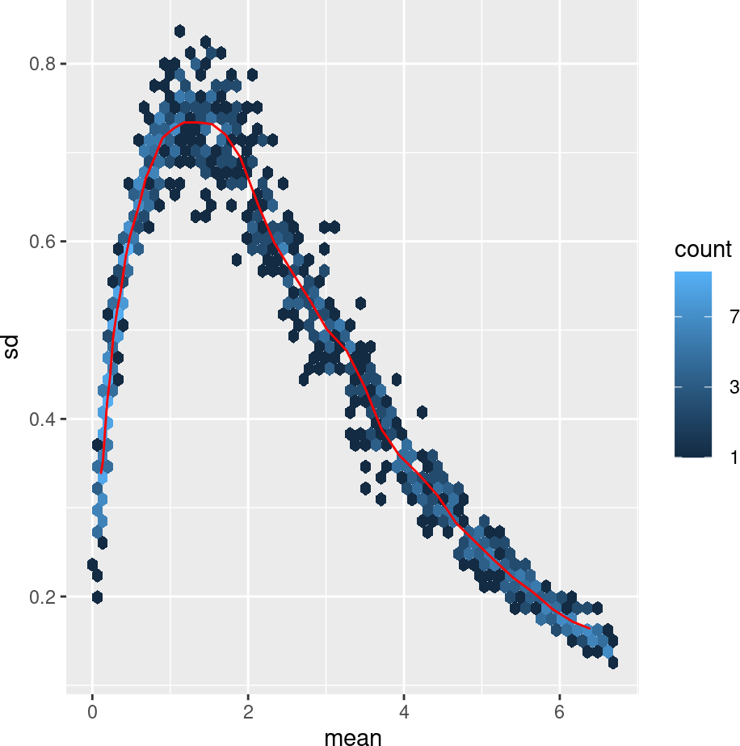
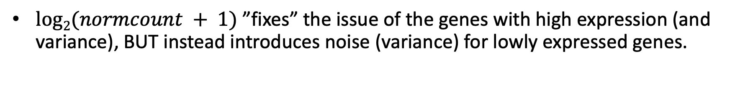
Data Tranformation – Log2
$log2(normcount + 1)$ ”fixes” the issue of the genes with high expression (and variance), BUT instead introduces noise (variance) for lowly expressed genes.
Raw
Log2(n+1)
Standard Deviation
Standard Deviation
Mean
Mean
Notes:
For genes with high counts, both the VST and the rlog will give similar result to the ordinary log2 transformation of normalized counts.
The VST or rlog-transformed data then become approximately homoskedastic (more flat trend in the meanSdPlot), and can be used directly for computing distances between samples.
The VST is much faster to compute and is less sensitive to high count outliers than the rlog.
The rlog tends to work well on small datasets (n < 30), potentially outperforming the VST when there is a wide range of sequencing depth across samples (an order of magnitude difference)

Slide 7
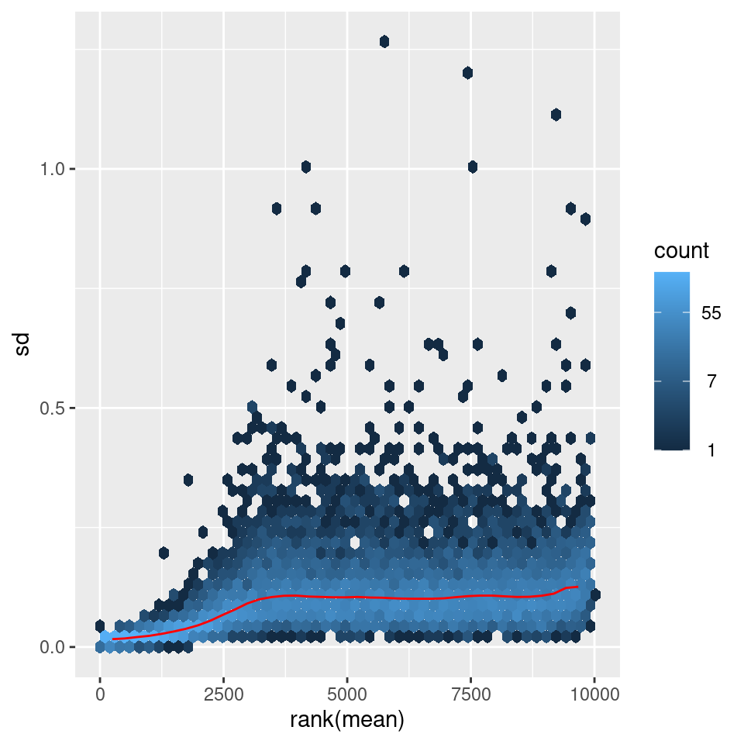
Data Tranformation – rlog & vst
Regularized logarithm (rlog) and variance stabilizing transformation (vst) remove the dependence of the variance on the expression mean.
For genes with low counts, the values are shrunken towards the genes' averages across all samples.
Log2(count + 1)
vst
rlog
Standard Deviation
Standard Deviation
rank(mean)
rank(mean)
rank(mean)
Notes:
For genes with high counts, both the VST and the rlog will give similar result to the ordinary log2 transformation of normalized counts.
The VST or rlog-transformed data then become approximately homoskedastic (more flat trend in the meanSdPlot), and can be used directly for computing distances between samples.
The VST is much faster to compute and is less sensitive to high count outliers than the rlog.
The rlog tends to work well on small datasets (n < 30), potentially outperforming the VST when there is a wide range of sequencing depth across samples (an order of magnitude difference)

Slide 8


Let’s Do Some Exploratory Analysis

Slide 9
Exploratory Analysis - Visualization
Now, we can compare our samples with a PCA or clustering (heatmap)
N.B: rlog and vst should not be used for Differential Expression Analysis (DEA)
Principal Component Analysis (PCA)
Principal Sample distances
rlog transformation

Slide 10
Exploratory Analysis - PCA
Principal Component Analysis
Visualize variation dataset of high dimensionality
Number of genes equals number of dimensions (d)
We can only interpret 2 or 3 dimensions
y
gene | Norm sampleA | Norm sampleB | s = 100
EF2A | 1145.39 | 1176.62 | …
ACBD1 | 16.92 | 16.88 | …
d = 20000 | … | … | …
x
z

Slide 11
Exploratory Analysis - PCA
Variation of genes is collapsed into Principal Components (PCs)
PC1
1st maximum variance
Little variation
geneB
geneA Expression
PC1
Highly variable
PC2
2nd maximum variance
PC2
geneB Expression
geneA

Slide 12
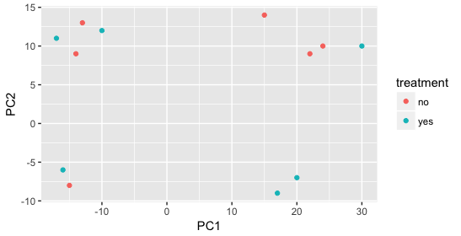
Exploratory Analysis - PCA
Variation of genes is collapsed into Principal Components (PCs)
Samples with similar gene expression related to PCs will be together
First PCs contain most variation
Usually PC1-PC4 are used
We need metadata to understand
source of variation

Slide 13
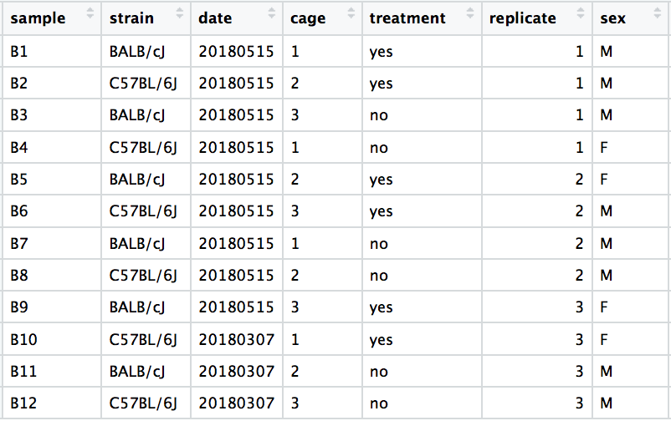
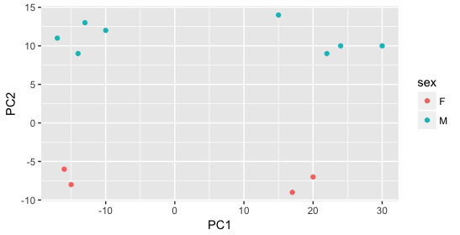
Exploratory Analysis - PCA
We need meta-data to understand

Slide 14
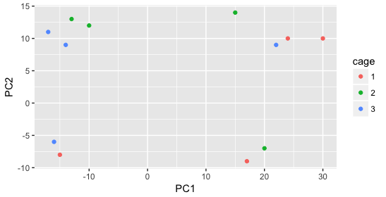
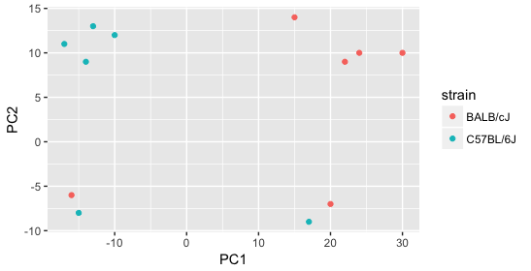
Exploratory Analysis - PCA
We need meta-data to understand

Slide 15
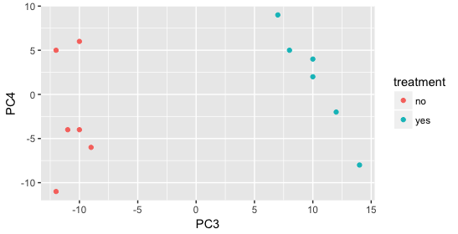
Exploratory Analysis - PCA
We need meta-data to understand

Slide 16
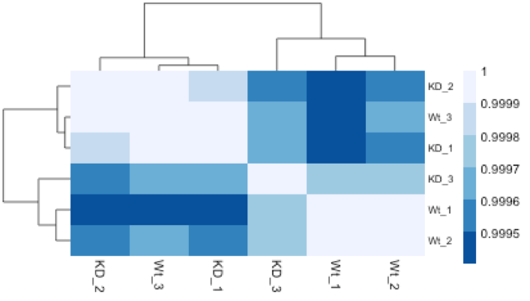
Exploratory analysis. Heatmaps
Hierarchical clustering and heatmaps
Cluster/group samples together
Can use:
Gene expression distances
Correlations
Heatmap and dendrogram
Complements the PCA

Slide 17
Exploratory Analysis - Visualization
An example of when something is not quite right…

